Slide 1

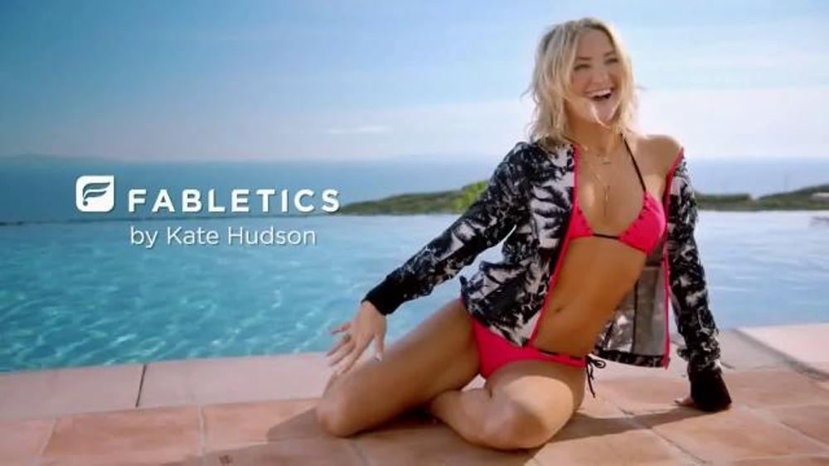
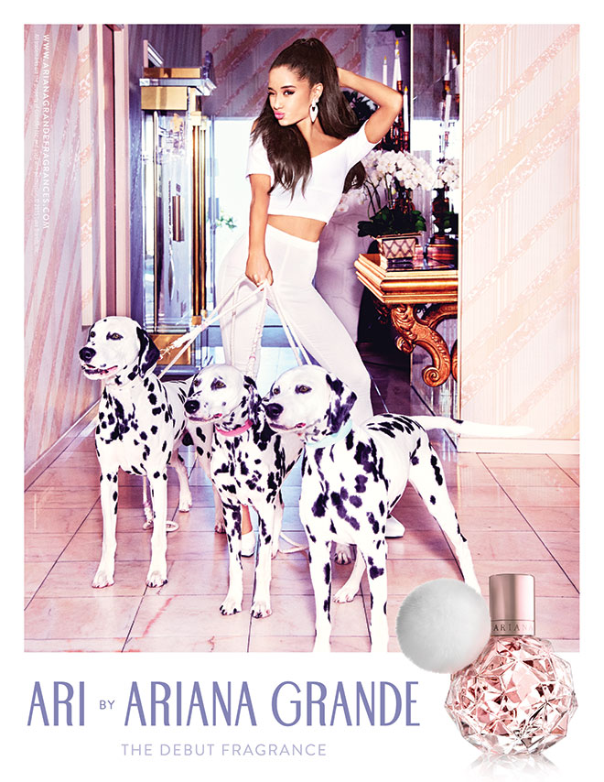






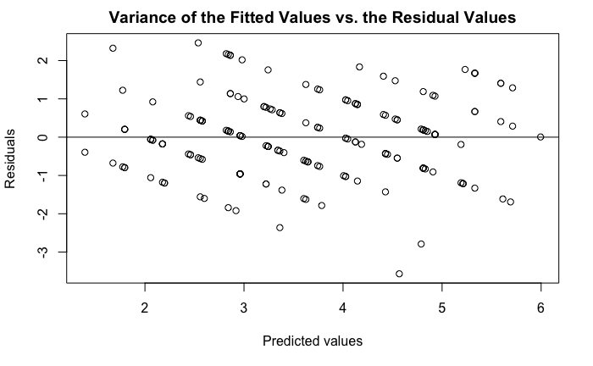
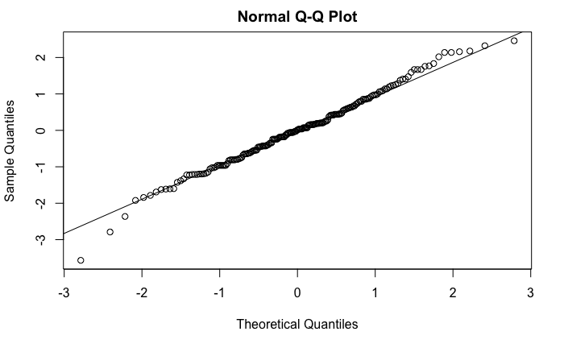
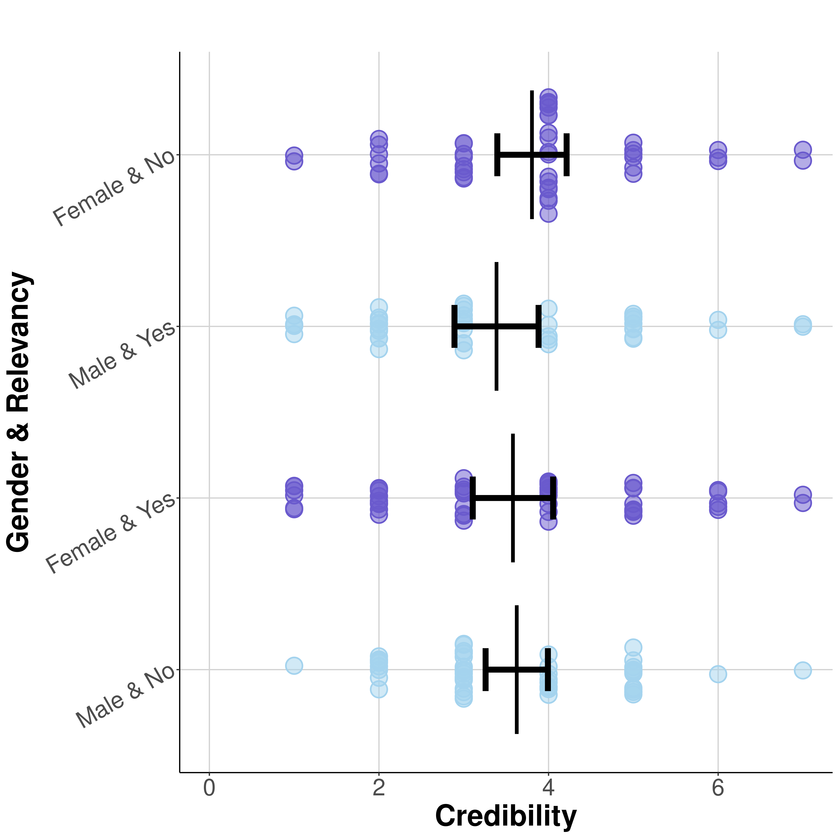
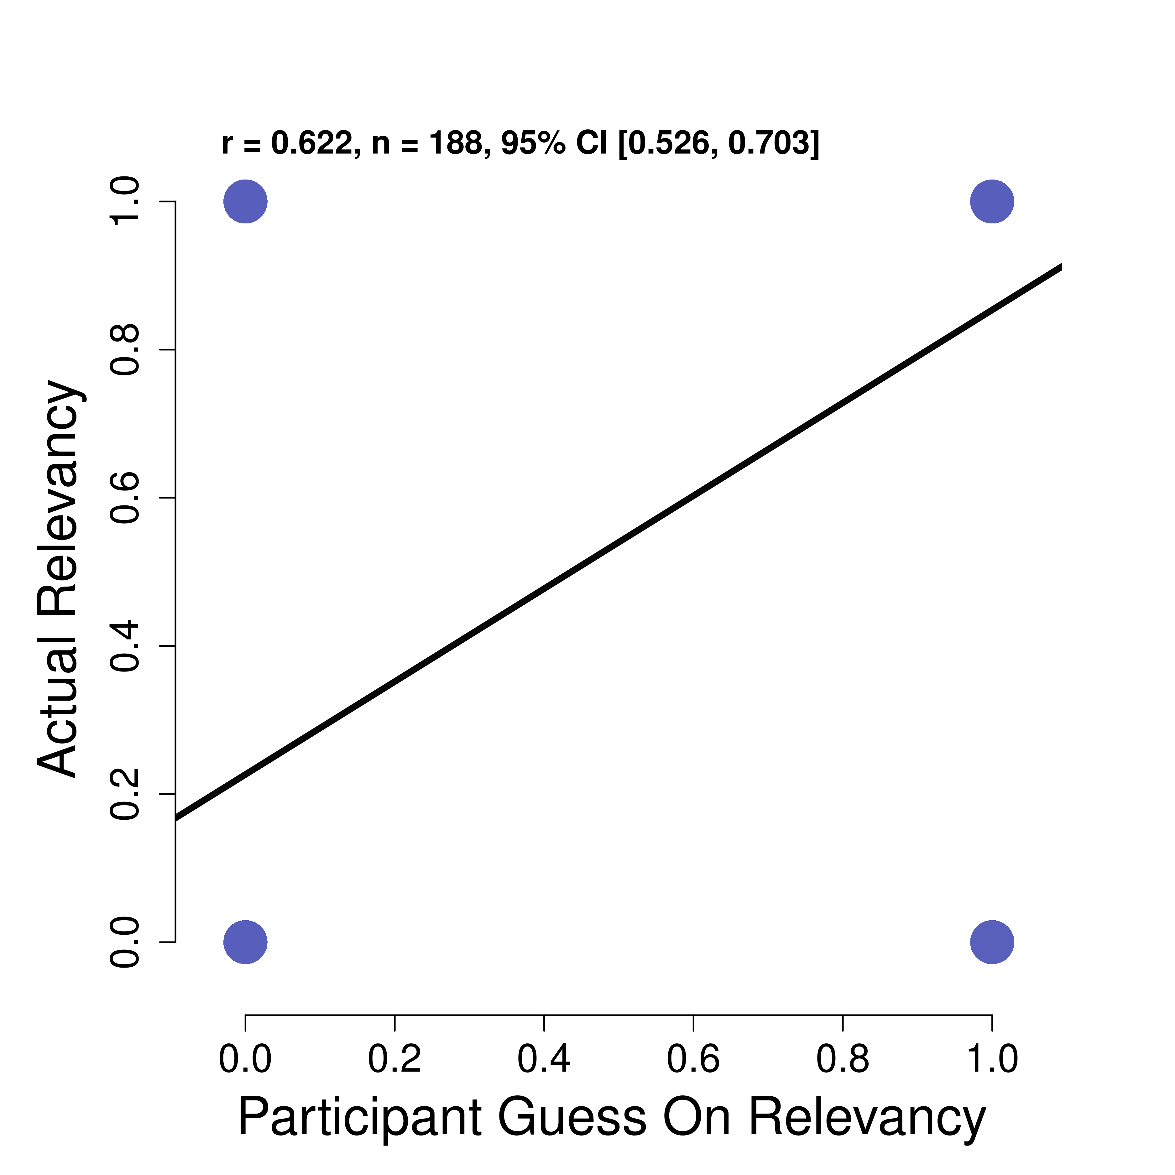
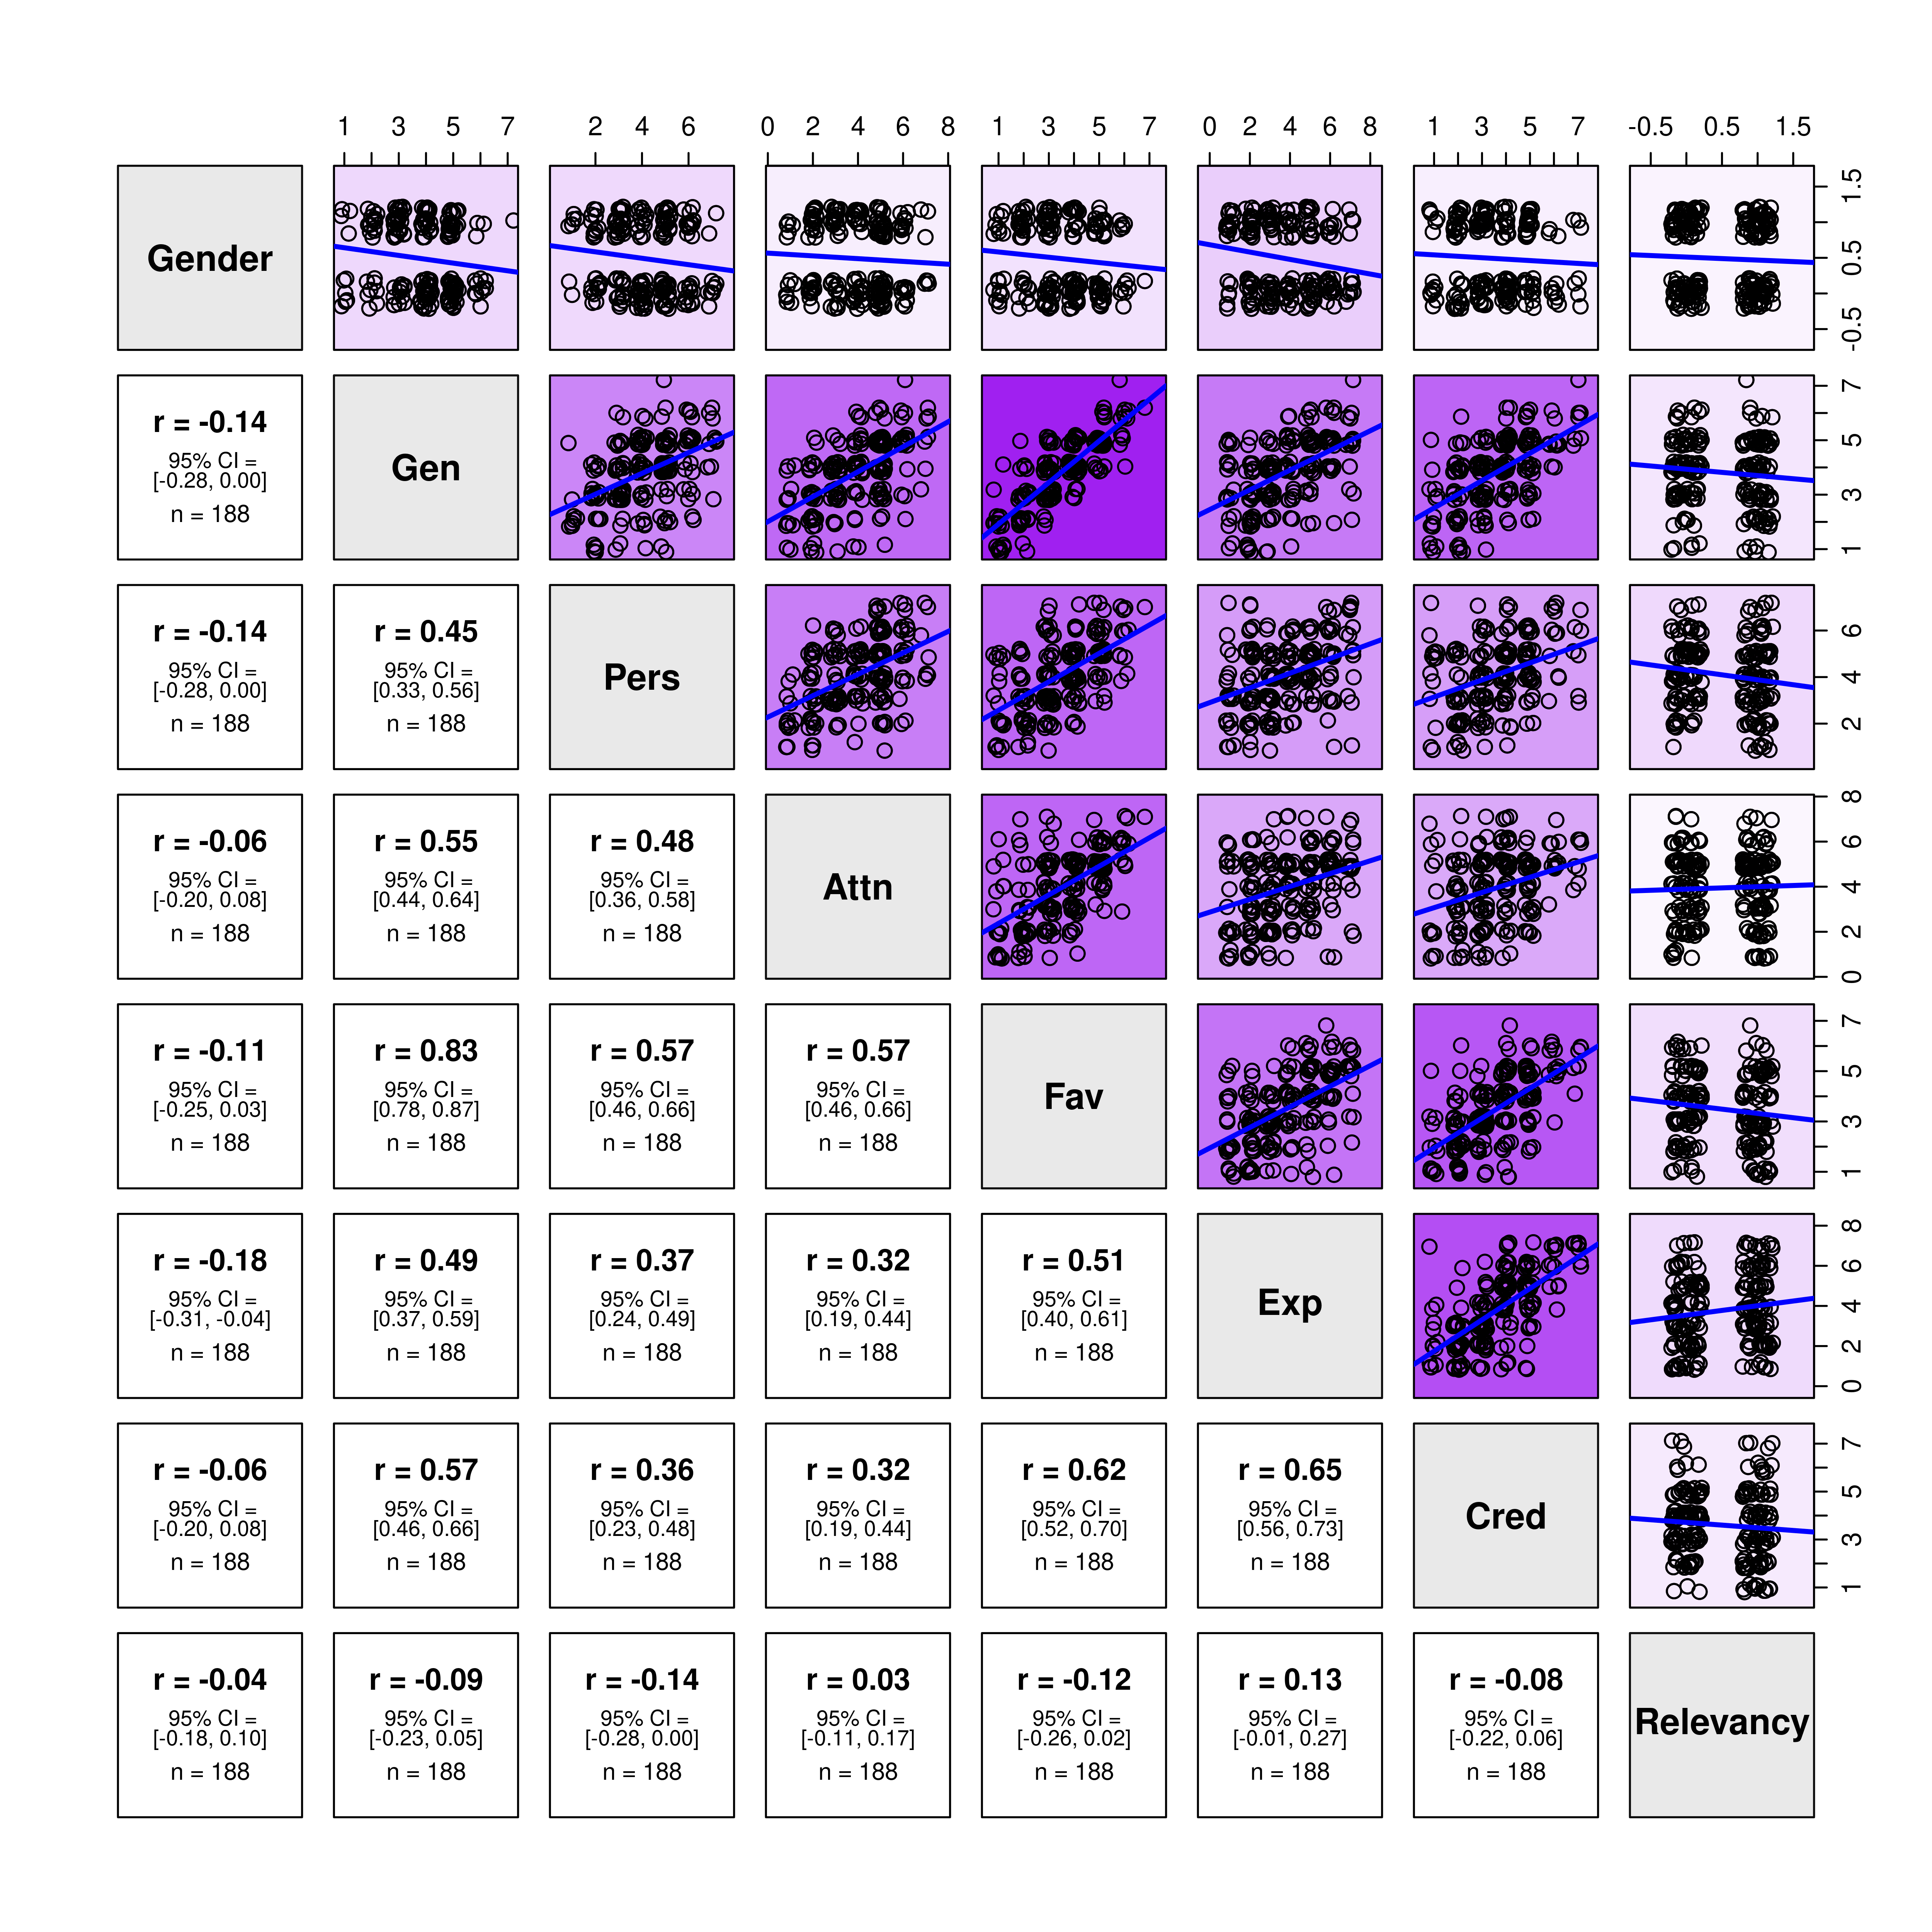
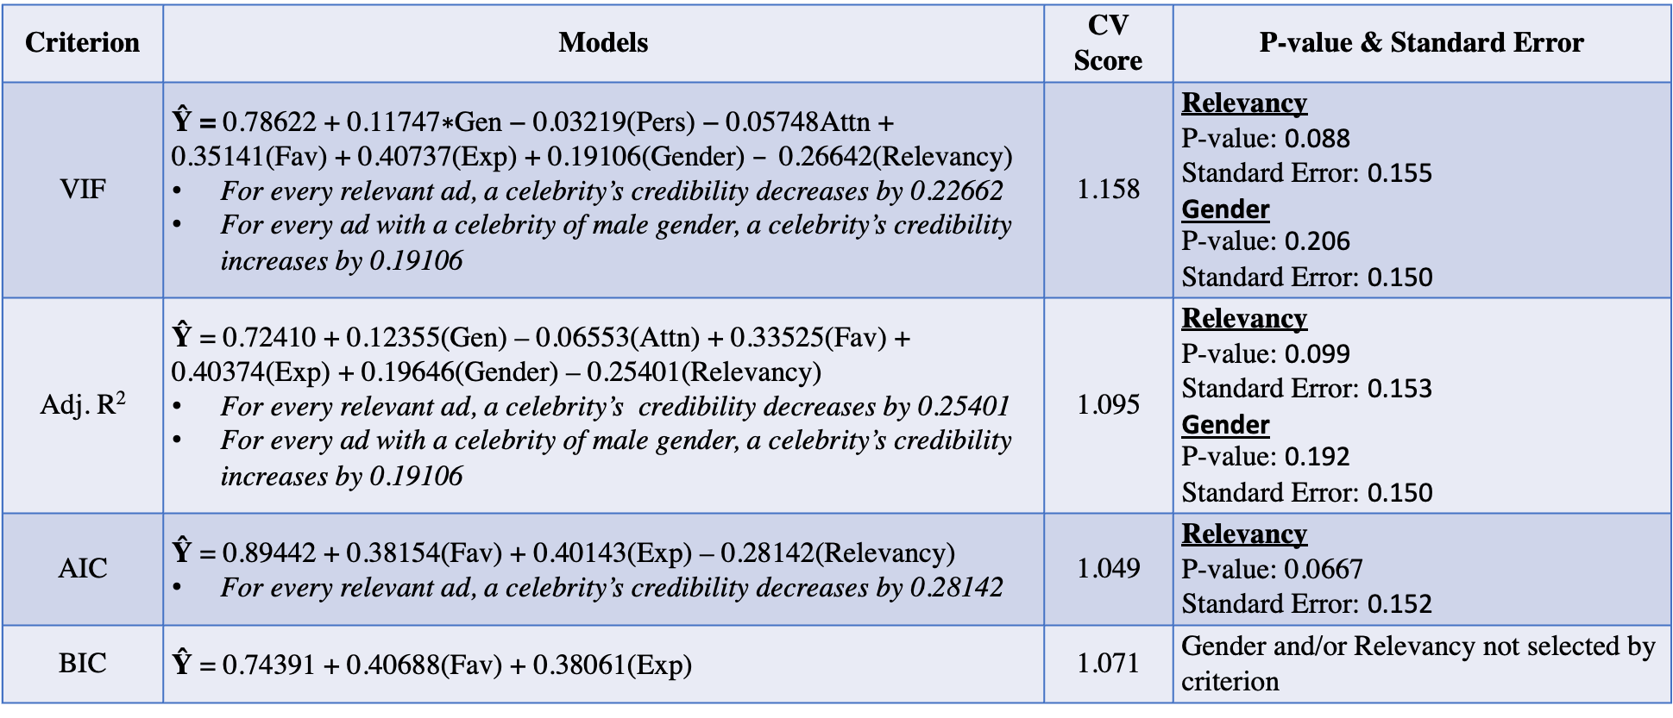
Celebrities: What makes them Credible?
Diana Hernandez, Class of 2022, Data Science Major Capstone
About the Project
Advertisements Utilized
Model-based Analysis
The capstone project is a continuation of a research project that includes contributions from students in PSYC 310R, Research Methods in Social Psychology. In this study, we were interested in what makes advertisements persuasive; in particular, what aspects of the communicator are important. This study was based on the match-up hypothesis, which suggests that models are more effective when they are relevant for the endorsed product compared to when they are less relevant for the product. More specifically, we were focusing on how a celebrity’s expertise may play a role in the effectiveness of the advertisement for the product. Participants were shown 5 adds. Two of these ads had a celebrity in them. The other three ads did not have a celebrity; they served as filler ads. We were only interested in participant’s responses to the celebrity ads.
In my continuation of the research project, I wanted to explore what factors make a celebrity a credible communicator. My response of interest is the celebrity’s credibility. I will be using the following predictors in my analysis (defined below): Gender, Relevancy, Gen, Pers, Attn, Fav, and Exp. My aim is to identify what components make an ad effective and lead viewers to deem the communicator of the ad as credible. My continuation of the project includes regression models and diagrams to demonstrate my findings. The data was collected from a population of Wellesley College students. They performed their task via a survey on Qualtrics
Criterion | Models | CV Score | P-value & Standard Error
VIF | $\text{Ŷ}$ $\text{=} \text{0.78622}\text{ +} \text{0.11747}\text{∗}\text{Gen}\text{ − 0.03219(}\text{Pers}\text{) − 0.05748}\text{Attn}\text{ + 0.35141(}\text{Fav}\text{) + 0.40737(}\text{Exp}\text{) + 0.19106(}\text{Gender}\text{) }–\text{ 0.26642(}\text{Relevancy}\text{) }$ For every relevant ad, a celebrity’s credibility decreases by 0.22662 For every ad with a celebrity of male gender, a celebrity’s credibility increases by 0.19106 | 1.158 | Relevancy P-value: 0.088 Standard Error: 0.155 Gender P-value: 0.206 Standard Error: 0.150
Adj. R² | $\text{Ŷ}$ = 0.72410 + 0.12355(Gen) – 0.06553(Attn) + 0.33525(Fav) + 0.40374(Exp) + 0.19646(Gender) – 0.25401(Relevancy) For every relevant ad, a celebrity’s credibility decreases by 0.25401 For every ad with a celebrity of male gender, a celebrity’s credibility increases by 0.19106 | 1.095 | Relevancy P-value: 0.099 Standard Error: 0.153 Gender P-value: 0.192 Standard Error: 0.150
AIC | $\text{Ŷ}$ = 0.89442 + 0.38154(Fav) + 0.40143(Exp) – 0.28142(Relevancy) For every relevant ad, a celebrity’s credibility decreases by 0.28142 | 1.049 | Relevancy P-value: 0.0667 Standard Error: 0.152
BIC | $\text{Ŷ}$ = 0.74391 + 0.40688(Fav) + 0.38061(Exp) | 1.071 | Gender and/or Relevancy not selected by criterion
Female Celebrity and Relevant
Female Celebrity and Not Relevant
The selection of the final model is based on the model with a low CV value as it indicates a stronger predictive power on independent observations. Thus, there is preference for the model obtained under the AIC criterion.
Variables
Final Model Diagnostics
Variables of initial interest
Gender: Gender of the celebrity (Independent variable #1)
Relevancy: Is the celebrity advertising their own product? (Independent variable #2)
Cred: “To what extent do you find the person/people in this ad to be (a) credible and trustworthy communicator(s)?” (Dependent variable)
Other variables to explore
Gen: “What is your general impression of the ad?”
Pers: “How effective do you think this ad is in persuading potential consumers?”
Attn : “How much did this ad draw your attention?”
Fav: “Do you judge this ad favorably?”
Exp: “To what extent do you think the person/people in this ad have expertise in the ad’s product category?”
The first two variables describe aspects of the stimulus ads; the rest are questions that were responded to by participants. Gender and Relevancy are categorical independent variables. The levels for Gender were defined as Female or Male. The levels for relevancy were defined as 0 and 1 with 0 meaning ”No” and 1 meaning “Yes.”
Male Celebrity and Relevant
Male Celebrity and Not Relevant
Plots
Relationship between Celebrity Credibility, Gender, and Relevancy to Ad
Figure 3
Figure 4
To consider the AIC model as the final model, further model diagnosis was conducted. Figure 3 and 4 were produced in order to identify any violations of multiple linear regression assumptions. Figure 3 does not violate the constant variance assumption as the distribution of the residuals is normally distributed across the abline. Although this pattern may seem unusual from typical linear regression models, the ranked-scaled data was treated as quantitative data. Therefore, it is not unusual to see the pattern displayed on figure 3. Figure 4 suggests that the normality assumption was not violated.
Questions of Interest
Figure 1: Demonstrates the relationship of Credibility, to a Celebrity’s gender and relevancy to the product. These results clearly do not support our two primary hypotheses: gender and relevancy do not appear to impact how credible a celebrity is perceived to be as communicator. Given that my main a priori hypotheses were unsupported, I conducted a series of follow-up analyses to explore the data more fully.
Discussion
Relationship between Participant Guess on Relevancy vs. Actual Relevancy
What attributes makes a celebrity in an ad an effective communicator? What is the impact of relevancy and gender to estimate credibility among an audience of Wellesley College undergraduates? Does relevancy and gender have no impact, a small impact, or a major impact on a celebrity’s credibility?
Correlation Matrix of Quantitative Variables
Hypotheses
Advertisements in which celebrities sell their own products are more effective than advertisements in which celebrities sell products they are hired for. Advertisements with female celebrities branding their own products will have the greatest effectiveness, followed by advertisements with male celebrities branding their own products.
Figure 5
Methodology
The final model suggests that how relevant a product is to the celebrity, how favorable we deem the ad, and a celebrity’s expertise on a product category are important factors to take into consideration in determining a celebrity’s credibility. However, figure 1 demonstrates that neither relevancy nor gender have a major effect on a celebrity’s credibility. Thus, there is not enough evidence to support relevancy or gender as significant factors. This core finding was confirmed in our model analysis. The data from one of the manipulation check questions regarding relevancy of the product was also explored, which is presented in Figure 5. Figure 5 shows that there is a moderate relationship between a participant’s guess on relevancy and the actual relevancy of the product. Given the correlation, there is a possibility that many participants did know about relevancy. However, this shows how relevancy, in general, may not be an important factor in a celebrity’s credibility. There are possible explanations that may have caused relevancy and gender to be weak variables in our analyses including but not limited to lack of diversity in ads and unrealistic perceptions of celebrities.
Several tests were done in order to identify what variables are effective in predicting the response variable of interest, credibility. The following criterion were used in order to obtain a final predictor model: VIF, Cp Mallow’s criterion, AIC selection, and BIC selection. Different models were obtained as a result of using these criterion. In order to determine a final model, the cross-validation score was computed. Four cross-validation scores were computed as Mallow’s Cp criterion resulted in the same model as the model obtained by the AIC criterion.
Figure 2: Demonstrates the correlation of variables to one another. A darker shade of purple indicates a strong correlation between both variables. A lighter shade of purple indicates a weak correlation between the two variables. Given that credibility is the response of interest, the correlation matrix tells us that variables Fav and Exp demonstrate a stronger correlation to credibility compared to the other variables. Gender and Relevancy, my variables of interest, demonstrated a weak correlation to credibility.

